Slide 1
Boolean & Integers
Boolean Algebra (2.1.7--2.1.10)
    Boolean algebra
    Expressing in C
Integers
    Numeric Encodings (2.2)
      Unsigned & Two’s complement
      C promotion rules
    Basic operations (2.3)
      Addition, negation, multiplication
      Consequences of overflow
      Using shifts to perform power-of-2 multiply/divide

Slide 2
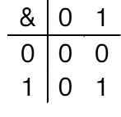
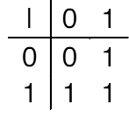
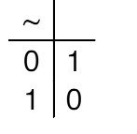
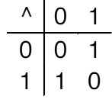
Boolean Algebra ≈ Integer Ring
Developed by George Boole in 19th Century
  Algebraic representation of logic
    Encode “True” as 1 and “False” as 0
  And
  A&B = 1 when both A=1 and B=1
Or
  A|B = 1 when either A=1 or B=1
Not
  ~A = 1 when A=0
Exclusive-Or (Xor)
  A^B = 1 when either A=1 or B=1, but not both

Slide 3
General Boolean Algebras
Operate on Bit Vectors
  Operations applied bitwise
All of the Properties of Boolean Algebra Apply
01101001
& 01010101
01000001
01101001
| 01010101
01111101
01101001
^ 01010101
00111100
~ 01010101
10101010
01000001
01111101
00111100
10101010

Slide 4
Bit-Level Operations in C
Operations &, |, ~, ^ Available in C
  Apply to any “integral” data type
    long, int, short, char
  View arguments as bit vectors
  Arguments applied bit-wise
Examples (Char data type)
  ~0x41 --> 0xBE
    ~01000001₂ --> 10111110₂
  ~0x00 --> 0xFF
    ~00000000₂ --> 11111111₂
  0x69 & 0x55 --> 0x41
    01101001₂ & 01010101₂ --> 01000001₂
  0x69 | 0x55 --> 0x7D
    01101001₂ | 01010101₂ --> 01111101₂

Slide 5
Contrast: Logic Operations in C
Contrast to Logical Operators
  &&, ||, !
    View 0 as “False”
    Anything nonzero as “True”
    Always return 0 or 1
    Early termination
Examples (char data type)
  !0x41 --> 0x00
  !0x00 --> 0x01
  !!0x41 --> 0x01
  0x69 && 0x55 --> 0x01
  0x69 || 0x55 --> 0x01

Slide 6
Cool Stuff with Xor
  Bitwise Xor is form of addition
  With extra property that every value is its own additive inverse
    A ^ A = 0
void funny(int *x, int *y)
{
*x = *x ^ *y; /* #1 */
*y = *x ^ *y; /* #2 */
*x = *x ^ *y; /* #3 */
}
*x
*y
Begin
A
B
1
A^B
B
2
A^B
(A^B)^B = A
3
(A^B)^A = B
A
End
B
A

Slide 7
Integers
Topics
    Numeric Encodings (2.2)
      Unsigned & Two’s complement
      C promotion rules
    Basic operations (2.3)
      Addition, negation, multiplication
      Consequences of overflow
      Using shifts to perform power-of-2 multiply/divide

Slide 8
Decimal Numbers
Digits: 0,1,…9
    49 – 2
      49 + (100 – 2) = 49 + 98 = 147 = 47
    2 – 49
      2 + (100 – 49) = 2 + 51 = 53 = -47
Pat. 10’s comp.
0 0
1 1
2 2
3 3
4 4
5 -5
6 -4
7 -3
8 -2
9 -1
Pat. 10’s comp
00 0
01 1
..
49 49
50 -50
51 -49
52 -48
..
98 -2
99 -1

Slide 9
Unsigned & Signed Numeric Values
Given n bits, all a matter of mapping (rule)
X | B2U(X) | B2S(X) | B2O(X) | B2T(X)
000 | 0 | 0 | 0 | 0
001 | 1 | 1 | 1 | 1
010 | 2 | 2 | 2 | 2
011 | 3 | 3 | 3 | 3
100 | 4 | -0 | -3 | -4
101 | 5 | -1 | -2 | -3
110 | 6 | -2 | -1 | -2
111 | 7 | -3 | -0 | -1

Slide 10
Unsigned & Signed Numeric Values
X
B2U(X)
B2T(X)
Equivalence
  Same encodings for nonnegative values
Uniqueness
  Every bit pattern represents unique integer value
  Each representable integer has unique bit encoding
⇒ Can Invert Mappings
  U2B(x) = B2U⁻¹(x)
    Bit pattern for unsigned integer
  T2B(x) = B2T⁻¹(x)
    Bit pattern for two’s comp integer
0000
0
0
0001
1
1
0010
2
2
0011
3
3
0100
4
4
0101
5
5
0110
6
6
0111
7
7
1000
8
–8
1001
9
–7
1010
10
–6
1011
11
–5
1100
12
–4
1101
13
–3
1110
14
–2
1111
15
–1

Slide 11
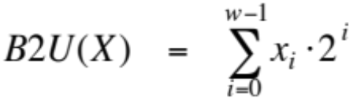
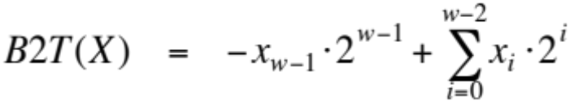
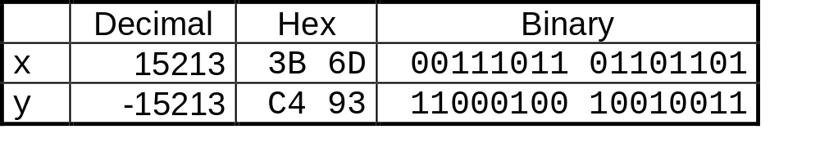
Encoding Integers
Unsigned
Two’s Complement
short int x = 15213;
short int y = -15213;
Sign
Bit
  C short 2 bytes long
Sign Bit
  For 2’s complement, most significant bit indicates sign
    0 for nonnegative
    1 for negative

Slide 12
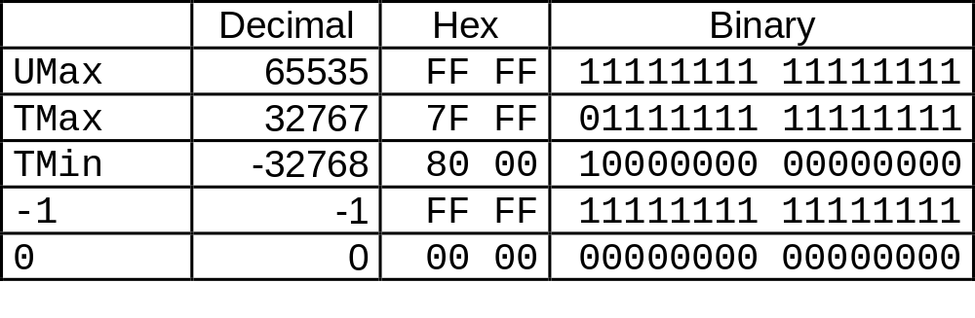
Numeric Ranges
Unsigned Values
  UMin = 0
    000…0
  UMax = 2^{w} – 1
    111…1
Two’s Complement Values
  TMin = –2^{w–1}
    100…0
  TMax = 2^{w–1} – 1
    011…1
Other Values
  Minus 1
    111…1
Values for W = 16

Slide 13
Two’s Complement
Given int x,
  -x = ~x + 1
  6-bit binary
    x = 010101₂ (21)
    -x = 101010 + 1 = 101011 (-32+8+3 = -21)
    x = 101011
    -x = 010101
    x = 100000 ?

Slide 14
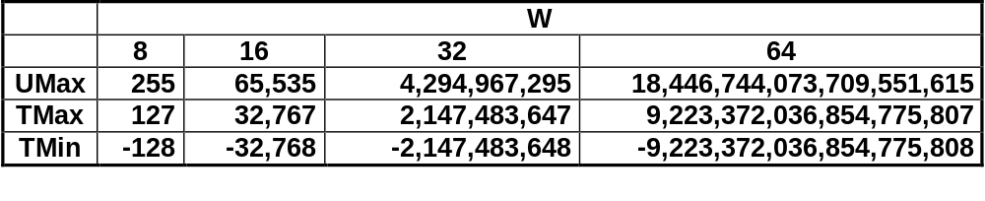
Values for Different Word Sizes
C Programming
  #include <limits.h>
    K&R App. B11
  Declares constants, e.g.,
    ULONG_MAX
    LONG_MAX
    LONG_MIN
  Values platform-specific
Observations
  |TMin | = TMax + 1
  Asymmetric range
    Umax = 2 * TMax + 1
  -Tmin ?

Slide 15
Prob. 2.19
X
T2B₄(X)
-8
-3
-2
-1
0
5

